Slide 1
Web Search and Mining
Lecture 9: Evaluation

Slide 2
This lecture
How do we know if our results are good?
  Evaluating a search engine
    Benchmarks
    Precision and recall
Results summaries:
  Making our good results usable to a user

Slide 3
EVALUATING SEARCH ENGINES

Slide 4
Measures for a search engine
Measures
How fast does it index
  Number of documents/hour
  (Average document size)
How fast does it search
  Latency as a function of index size
Expressiveness of query language
  Ability to express complex information needs
  Speed on complex queries
Uncluttered UI
Is it free?

Slide 5
Measures for a search engine
Measures
All of the preceding criteria are measurable: we can quantify speed/size
  we can make expressiveness precise
The key measure: user happiness
  What is this?
  Speed of response/size of index are factors
  But blindingly fast, useless answers won’t make a user happy
Need a way of quantifying user happiness

Slide 6
Measuring user happiness
Measures
Issue: who is the user we are trying to make happy?
  Depends on the setting
Web engine:
  User finds what they want and return to the engine
    Can measure rate of return users
  User completes their task – search as a means, not end
  See Russell http://dmrussell.googlepages.com/JCDL-talk-June-2007-short.pdf
eCommerce site: user finds what they want and buy
  Is it the end-user, or the eCommerce site, whose happiness we measure?
  Measure time to purchase, or fraction of searchers who become buyers?

Slide 7
Measuring user happiness
Measures
Enterprise (company/govt/academic): Care about “user productivity”
  How much time do my users save when looking for information?
  Many other criteria having to do with breadth of access, secure access, etc.

Slide 8
Happiness: elusive to measure
Measures
Most common proxy: relevance of search results
But how do you measure relevance?
We will detail a methodology here, then examine its issues
Relevance measurement requires 3 elements:
  A benchmark document collection
  A benchmark suite of queries
  A usually binary assessment of either Relevant or Nonrelevant for each query and each document
    Some work on more-than-binary, but not the standard

Slide 9
Evaluating an IR system
Measures
Note: the information need is translated into a query
Relevance is assessed relative to the information need not the query
E.g., Information need: I'm looking for information on whether drinking red wine is more effective at reducing your risk of heart attacks than white wine.
Query: wine red white heart attack effective
You evaluate whether the doc addresses the information need, not whether it has these words

Slide 10
Standard relevance benchmarks
Benchmarks
TREC - National Institute of Standards and Technology (NIST) has run a large IR test bed for many years
Reuters and other benchmark doc collections used
“Retrieval tasks” specified
  sometimes as queries
Human experts mark, for each query and for each doc, Relevant or Nonrelevant
  or at least for subset of docs that some system returned for that query

Slide 11
Unranked retrieval evaluation:
Precision and Recall
Unranked Retrieval Evaluation
Precision: fraction of retrieved docs that are relevant = P(relevant|retrieved)
Recall: fraction of relevant docs that are retrieved = P(retrieved|relevant)
Precision P = tp/(tp + fp)
Recall R = tp/(tp + fn)
 | Relevant | Nonrelevant
Retrieved | tp | fp
Not Retrieved | fn | tn

Slide 12
Should we instead use the accuracy measure for evaluation?
Unranked Retrieval Evaluation
Given a query, an engine classifies each doc as “Relevant” or “Nonrelevant”
The accuracy of an engine: the fraction of these classifications that are correct
  (tp + tn) / ( tp + fp + fn + tn)
Accuracy is a commonly used evaluation measure in machine learning classification work
Why is this not a very useful evaluation measure in IR?

Slide 13
Why not just use accuracy?
Unranked Retrieval Evaluation
How to build a 99.9999% accurate search engine on a low budget….
People doing information retrieval want to find something and have a certain tolerance for junk.
Snoogle.com
Search for:
0 matching results found.

Slide 14
Precision/Recall
Unranked Retrieval Evaluation
You can get high recall (but low precision) by retrieving all docs for all queries!
Recall is a non-decreasing function of the number of docs retrieved
In a good system, precision decreases as either the number of docs retrieved or recall increases
  This is not a theorem, but a result with strong empirical confirmation

Slide 15
Difficulties in using precision/recall
Unranked Retrieval Evaluation
Should average over large document collection/query ensembles
Need human relevance assessments
  People aren’t reliable assessors
Assessments have to be binary
  Nuanced assessments?
Heavily skewed by collection/authorship
  Results may not translate from one domain to another

Slide 16
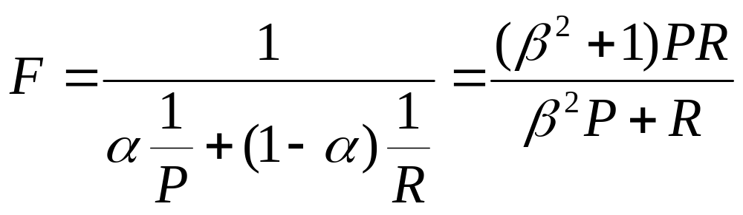
A combined measure: F
Unranked Retrieval Evaluation
Combined measure that assesses precision/recall tradeoff is F measure (weighted harmonic mean):
People usually use balanced F₁ measure
  i.e., with β = 1 or α = ½
Harmonic mean is a conservative average
  See CJ van Rijsbergen, Information Retrieval

Slide 17
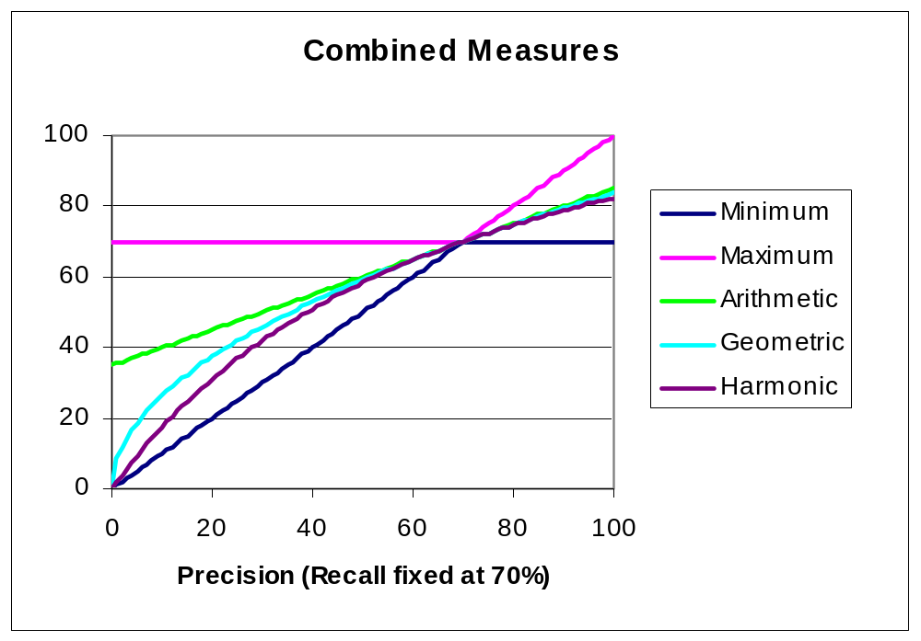
F₁ and other averages
Unranked Retrieval Evaluation

Slide 18
Evaluating ranked results
Ranked Retrieval Evaluation
Evaluation of ranked results:
  The system can return any number of results
  By taking various numbers of the top returned documents (levels of recall), the evaluator can produce a precision-recall curve

Slide 19
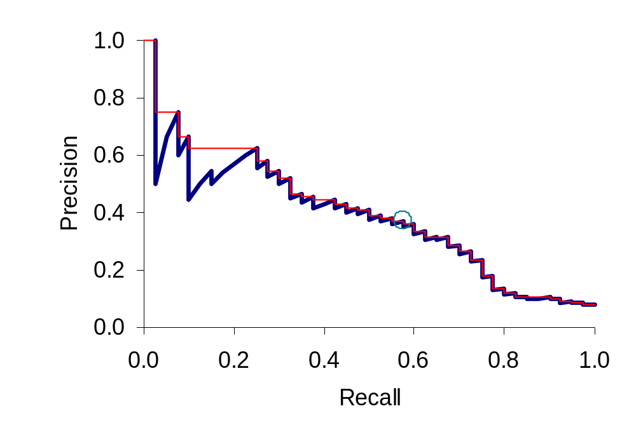
A precision-recall curve
Ranked Retrieval Evaluation

Slide 20
Averaging over queries
Ranked Retrieval Evaluation
A precision-recall graph for one query isn’t a very sensible thing to look at
You need to average performance over a whole bunch of queries.
But there’s a technical issue:
  Precision-recall calculations place some points on the graph
  How do you determine a value (interpolate) between the points?

Slide 21
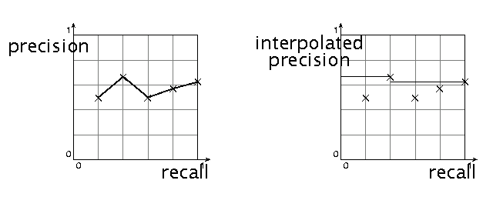
Interpolated precision
Ranked Retrieval Evaluation
Idea: If locally precision increases with increasing recall, then you should get to count that…
So you max of precisions to right of value

Slide 22
Evaluation
Ranked Retrieval Evaluation
Graphs are good, but people want summary measures!
  Precision at fixed retrieval level
    Precision-at-k: Precision of top k results
    Perhaps appropriate for most of web search: all people want are good matches on the first one or two results pages
    But: averages badly and has an arbitrary parameter of k
  11-point interpolated average precision
    The standard measure in the early TREC competitions: you take the precision at 11 levels of recall varying from 0 to 1 by tenths of the documents, using interpolation (the value for 0 is always interpolated!), and average them
    Evaluates performance at all recall levels

Slide 23
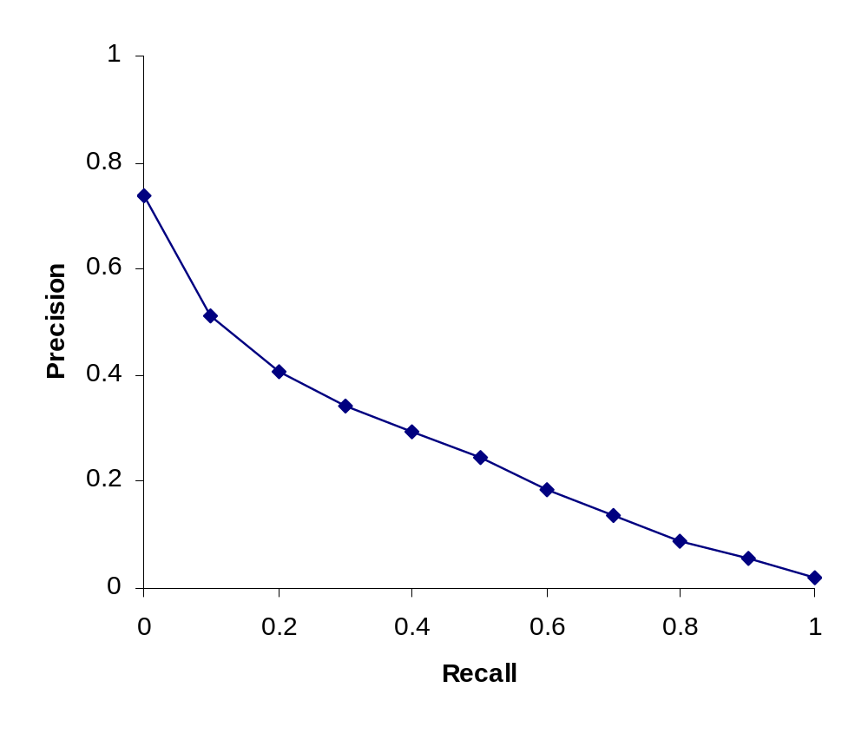
Typical (good) 11 point precisions
Ranked Retrieval Evaluation
SabIR/Cornell 8A1 11pt precision from TREC 8 (1999)

Slide 24
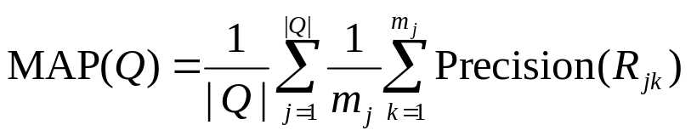





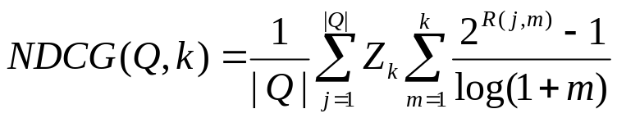
Yet more evaluation measures…
Ranked Retrieval Evaluation
Mean average precision (MAP)
  : a set of information need
  : the set of relevant documents for
  : the set of ranked retrieval results from the top result until you get to document
Normalized discounted cumulative gain (NDCG)
R(j,m) is the relevance score assessors give to document m for query j
Zk is a normalization factor calculated to make it so that a perfect ranking’s NDCG at k is 1.

Slide 25
Variance
Ranked Retrieval Evaluation
For a test collection, it is usual that a system does crummily on some information needs (e.g., MAP = 0.1) and excellently on others (e.g., MAP = 0.7)
Indeed, it is usually the case that the variance in performance of the same system across queries is much greater than the variance of different systems on the same query.
That is, there are easy information needs and hard ones!

Slide 26
CREATING TEST COLLECTIONS
FOR IR EVALUATION

Slide 27
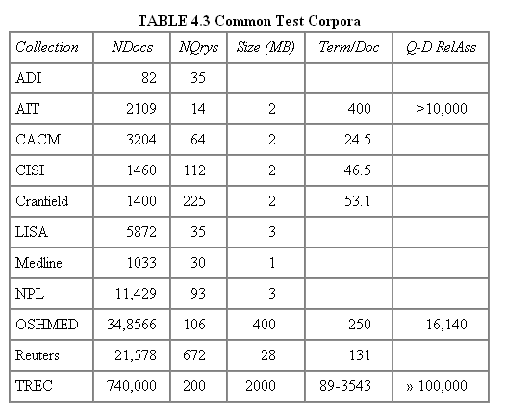
Test Collections
Assessing Relevance

Slide 28
From document collections to test collections
Assessing Relevance
Still need
  Test queries
  Relevance assessments
Test queries
  Must be germane to docs available
  Best designed by domain experts
  Random query terms generally not a good idea
Relevance assessments
  Human judges, time-consuming
  Are human panels perfect?

Slide 29
Unit of Evaluation
Assessing Relevance
We can compute precision, recall, F, and MAP for different units.
Possible units
  Documents (most common)
  Facts (used in some TREC evaluations)
  Entities (e.g., car companies)
May produce different results. Why?

Slide 30
Kappa measure for inter-judge (dis)agreement
Assessing Relevance
Kappa measure
  Agreement measure among judges
  Designed for categorical judgments
  Corrects for chance agreement
Kappa = [ P(A) – P(E) ] / [ 1 – P(E) ]
P(A) – proportion of the times the judges agree
P(E) – what agreement would be by chance
Kappa = 0 for chance agreement, 1 for total agreement.

Slide 31
Kappa Measure: Example
Assessing Relevance
P(A)? P(E)?
Number of docs | Judge 1 | Judge 2
300 | Relevant | Relevant
70 | Nonrelevant | Nonrelevant
20 | Relevant | Nonrelevant
10 | Nonrelevant | Relevant

Slide 32
Kappa Example
Assessing Relevance
P(A) = 370/400 = 0.925
P(nonrelevant) = (10+20+70+70)/800 = 0.2125
P(relevant) = (10+20+300+300)/800 = 0.7878
P(E) = 0.2125^2 + 0.7878^2 = 0.665
Kappa = (0.925 – 0.665)/(1-0.665) = 0.776
Kappa > 0.8 = good agreement
0.67 < Kappa < 0.8 -> “tentative conclusions” (Carletta ’96)
Depends on purpose of study
For >2 judges: average pairwise kappas

Slide 33
TREC
Assessing Relevance
TREC Ad Hoc task from first 8 TRECs is standard IR task
  50 detailed information needs a year
  Human evaluation of pooled results returned
  More recently other related things: Web track, HARD
A TREC query (TREC 5)
  <top>
  <num> Number: 225
  <desc> Description:
  What is the main function of the Federal Emergency Management Agency (FEMA) and the funding level provided to meet emergencies? Also, what resources are available to FEMA such as people, equipment, facilities?
  </top>

Slide 34
Standard relevance benchmarks: Others
Assessing Relevance
GOV2
  Another TREC/NIST collection
  25 million web pages
  Largest collection that is easily available
  But still 3 orders of magnitude smaller than what Google/Yahoo/MSN index
NTCIR
  East Asian language and cross-language information retrieval
Cross Language Evaluation Forum (CLEF)
  This evaluation series has concentrated on European languages and cross-language information retrieval.
Many others

Slide 35
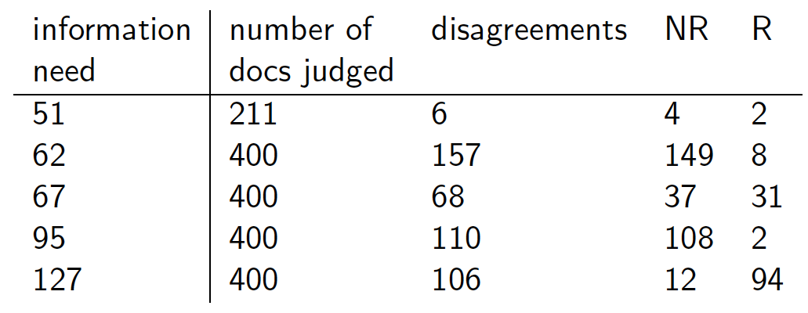
Interjudge Agreement: TREC 3
Assessing Relevance
Notes:
Topic is TREC topic
Judged is number of documents that human assessors judged
Diff is the number that they disagreed on.
NR and R are whether those were eventually classified as relevant or nonrelevant.

Slide 36
Impact of Inter-judge Agreement
Assessing Relevance
Impact on absolute performance measure can be significant (0.32 vs 0.39)
Little impact on ranking of different systems or relative performance
Suppose we want to know if algorithm A is better than algorithm B
A standard information retrieval experiment will give us a reliable answer to this question.

Slide 37
Critique of pure relevance
Assessing Relevance
Relevance vs Marginal Relevance
  A document can be redundant even if it is highly relevant
  Duplicates
  The same information from different sources
  Marginal relevance is a better measure of utility for the user.
Using facts/entities as evaluation units more directly measures true relevance.
But harder to create evaluation set
See Carbonell reference

Slide 38
Can we avoid human judgment?
Assessing Relevance
No
Makes experimental work hard
  Especially on a large scale
In some very specific settings, can use proxies
  E.g.: for approximate vector space retrieval, we can compare the cosine distance closeness of the closest docs to those found by an approximate retrieval algorithm
But once we have test collections, we can reuse them (so long as we don’t overtrain too badly)

Slide 39
Evaluation at large search engines
Assessing Relevance
Search engines have test collections of queries and hand-ranked results
Recall is difficult to measure on the web
Search engines often use precision at top k, e.g., k = 10
. . . or measures that reward you more for getting rank 1 right than for getting rank 10 right.
  NDCG (Normalized Discounted Cumulative Gain
Search engines also use non-relevance-based measures.
  Clickthrough on first result
    Not very reliable if you look at a single clickthrough … but pretty reliable in the aggregate.
  Studies of user behavior in the lab
  A/B testing
Notes:
Not very reliable if you look at a single clickthrough (you may
realize after clicking that the summary was misleading and the
document is nonrelevant) . . .

Slide 40
A/B testing
Assessing Relevance
Purpose: Test a single innovation
Prerequisite: You have a large search engine up and running.
Have most users use old system
Divert a small proportion of traffic (e.g., 1%) to the new system that includes the innovation
Evaluate with an “automatic” measure like clickthrough on first result
Now we can directly see if the innovation does improve user happiness.
Probably the evaluation methodology that large search engines trust most
In principle less powerful than doing a multivariate regression analysis, but easier to understand

Slide 41
RESULTS PRESENTATION

Slide 42
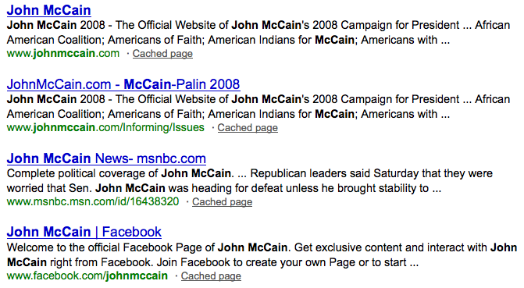
Result Summaries
Result Summaries
Having ranked the documents matching a query, we wish to present a results list
Most commonly, a list of the document titles plus a short summary, aka “10 blue links”

Slide 43
Summaries
Result Summaries
The title is often automatically extracted from document metadata. What about the summaries?
  This description is crucial.
  User can identify good/relevant hits based on description.
Two basic kinds:
  Static
  Dynamic
A static summary of a document is always the same, regardless of the query that hit the doc
A dynamic summary is a query-dependent attempt to explain why the document was retrieved for the query at hand

Slide 44
Static summaries
Result Summaries
In typical systems, the static summary is a subset of the document
Simplest heuristic: the first 50 (or so – this can be varied) words of the document
  Summary cached at indexing time
More sophisticated: extract from each document a set of “key” sentences
  Simple NLP heuristics to score each sentence
  Summary is made up of top-scoring sentences.
Most sophisticated: NLP used to synthesize a summary
  Seldom used in IR; cf. text summarization work

Slide 45






Dynamic summaries
Result Summaries
Present one or more “windows” within the document that contain several of the query terms
  “KWIC” snippets: Keyword in Context presentation

Slide 46
Techniques for dynamic summaries
Result Summaries
Find small windows in doc that contain query terms
  Requires fast window lookup in a document cache
Score each window wrt query
  Use various features such as window width, position in document, etc.
  Combine features through a scoring function – methodology to be covered later
Challenges in evaluation: judging summaries
  Easier to do pairwise comparisons rather than binary relevance assessments

Slide 47

Quicklinks
Result Summaries
For a navigational query such as united airlines user’s need likely satisfied on www.united.com
Quicklinks provide navigational cues on that home page

Slide 48


Result Summaries

Slide 49
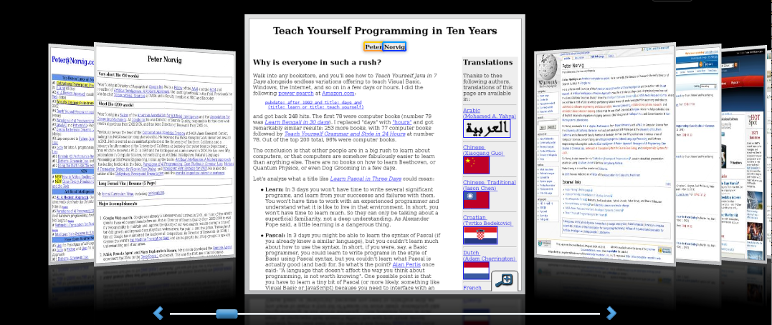
Alternative results presentations?
An active area of HCI research
An alternative: http://www.searchme.com / copies the idea of Apple’s Cover Flow for search results
  (searchme recently went out of business)
Notes:
For the moment, the search engine market has really coalesced around one dominant style (consistency has strong benefits – Jakob Nielsen.

Slide 50
Resources for this lecture
IIR 8
Carbonell and Goldstein 1998. The use of MMR, diversity-based reranking for reordering documents and producing summaries. SIGIR 21.

